Slide 1
CAPSTONE PROJECT -1 Hotel Booking Analysis
Team Members
Abhash Jain
Mounika Dontula
Karan Rawat

Slide 2
Points to Discuss:
Agenda
Data summary
Data wrangling
Data analysis
Data visualisation
Summary

Slide 3

Agenda
To discuss the analysis of given hotel bookings data set from 2015-2017.
We’ll be doing analysis of given data set in following ways :
Booking wise analysis.
Guest wise analysis.
Type of visitors.
Month wise analysis.
Room wise analysis.
Guest wise analysis.
Room wise analysis.
By doing this we’ll try to find out key factors driving the hotel bookings trends.

Slide 4
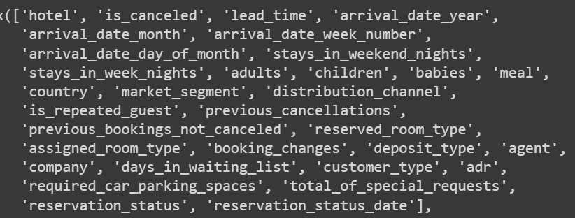
Data Summary
.
The data set contains booking information of city hotel and resort hotel the dataset has a shape of (119210,32) which means the dataset contains 119210 rows and 32 columns.
The data set contains booking information of city hotel and resort hotel. It contains the information like hotel type , when the booking was made , room type , revenue ,length of stay , lead time etc. Among other thing personal information has been deleted from the database.
The picture represents the data of booking.

Slide 5


Data Wrangling
Data Cleaning
The Data file consists of some null values “Nan”.
Replacing those null values with zero, median and mode.
Checking for outliers.
Data Preparation
Data file consists of different types of data.
Data type: integer , float , objects.
Dropping some of the rows which don’t have values.

Slide 6
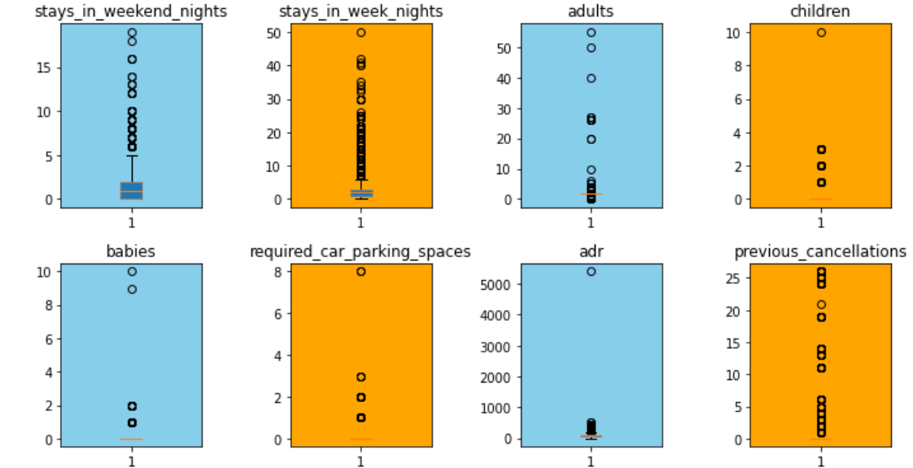
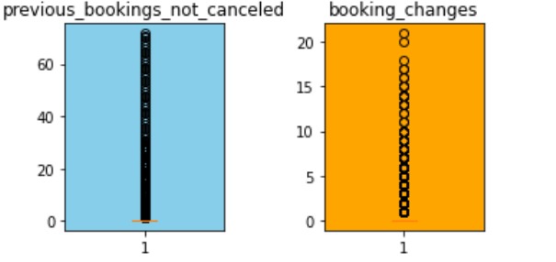
Checking for outliers
In the dataset there are binary features like 'is_canceled', 'is_repeated_guest' which are mapped to float data type. There are outliers also, as we can see mean and median difference is quiet large for most of the features.
We have selected certain columns to check for outliers.
We made a subplot with 3 rows and 4 columns.
Plotting each feature's boxplot to check outliers.
Removing left out blank subplots.

Slide 7
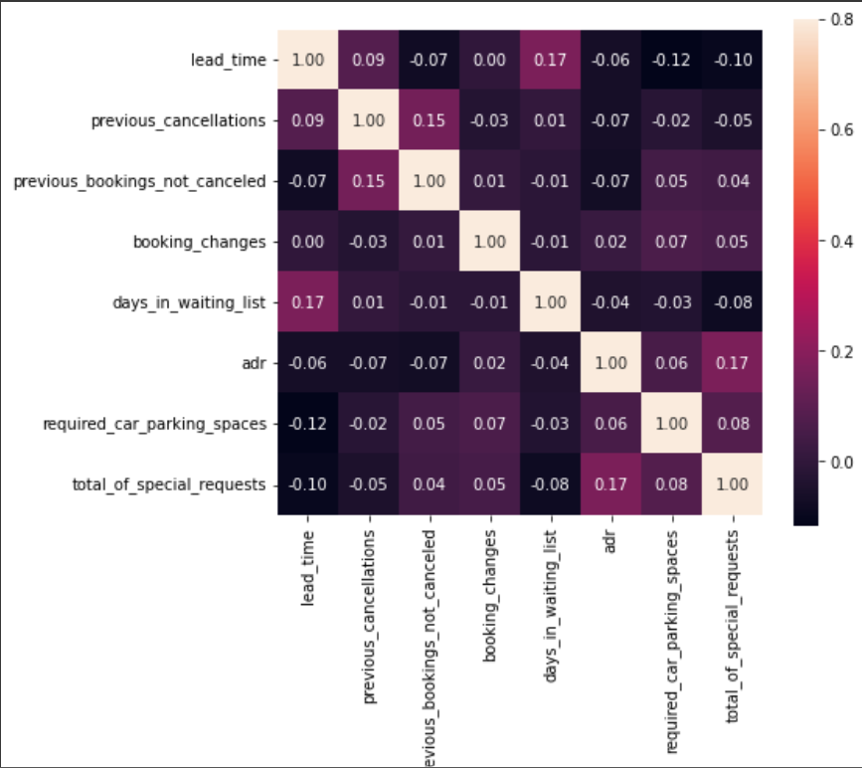
Correlation With Heatmap
We can see that days_in_waiting_list is slightly corelated with lead_time.
adr is corelated to total_of special_requests.

Slide 8

Booking wise analysis
How many booking cancelled each year?
What is the booking difference between weekends and week days night?
From which market segment bookings done the most?
What is the booking percentage difference between city hotel and resort hotel?
What are the bookings percentage each year?

Slide 9
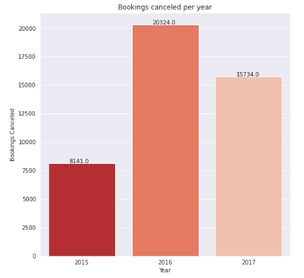
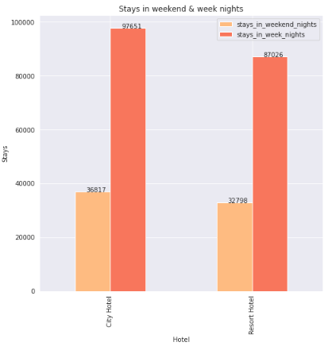
Booking wise analysis...
The 37% of bookings got cancelled.
In 2015, the 8141 bookings were cancelled.
In 2016, the 20324 bookings were cancelled.
In 2017, the 15734 bookings were cancelled.
Second plot shows the difference of booking between weekends and week days night stays in hotel.
Total guests stays in week nights are 184677 in that 97651 are from city hotel and 87026 are resort hotel.
Total guests stays in weekend nights are 69615 in that 36817 stays in city hotel and 32798 stays in resort hotel.

Slide 10
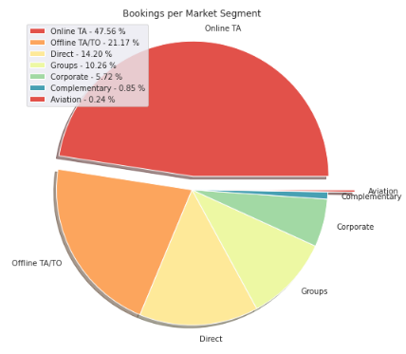
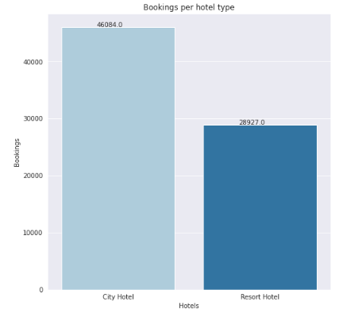
Booking wise analysis...
This plot shows the bookings per market segments.
We can see that most of the booking are done through online TA i.e. 47.56%
The least booking done through complementary and aviation.
This plot shows the booking percentage between city hotel and resort hotel.
More than 60% of the population booked the City hotel i.e. 46084 .

Slide 11
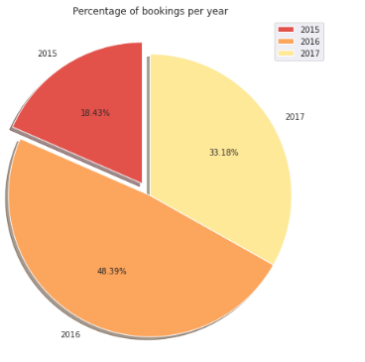
Booking wise analysis...
This figure shows that the percentage of booking per year.
More bookings were made in year 2016, compared to the previous year. But the bookings decreased by almost 15% the next year.

Slide 12
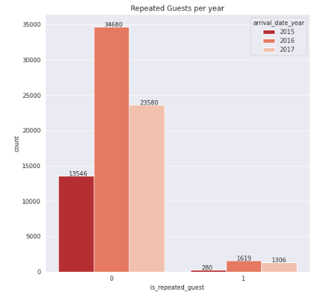
Guest wise analysis
How many guests repeated each year?
This figure shows that are there any repeated guests through years.
1 means guest repeated and 0 means guest not repeated.
In the year 2015 - 280 guests were repeated.
In the year 2016- 1619 guests were repeated.
In the year 2017- 1306 guests were repeated.
Highest guests were repeated in the year 2016.

Slide 13

Type of visitors wises analysis
Which is the most booked accommodation type?
From which country visitors comes the most?

Slide 14
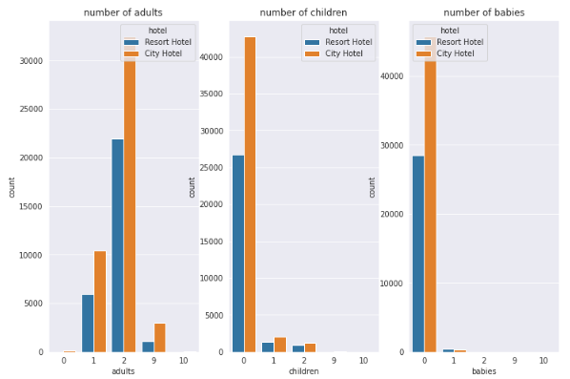
Type of visitors wises analysis...
This graph shows the type of visitors those are adults , children and babies.
Most of the visitors travel in pairs. They mostly prefer city hotel.
Visitors with children are very few and they mostly prefer city hotel
Visitors with babies prefer resort hotel for their comfort.

Slide 15
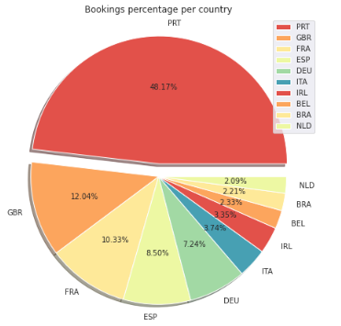
Type of visitors wises analysis...
This pie chart shows the booking percentage with respect to country code.
We can see in the chart majority of the visitors are from country Portugal..
The countries UK , France, Spain and Gremany also holds a great portion in bookings .
The approx. 70% comes from these 5 countries.
The least visitors are from country Netherlands.

Slide 16

Month wise analysis
Which is the most occupied month for hotels?
What is the average daily rate for each month per hotel type?

Slide 17
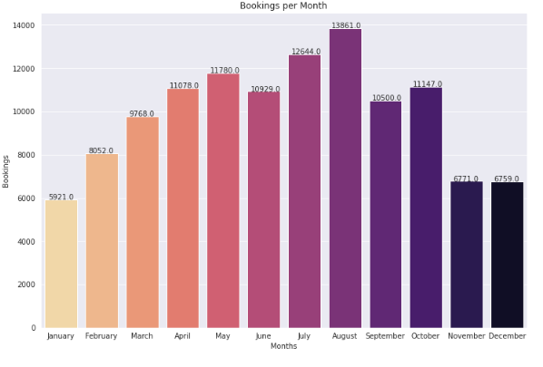
Month wise analysis...
This bar chart shows booking for each month.
As we can see in below chart most of the bookings were made from July to August.
And the least bookings were made at the start and end of the year.

Slide 18
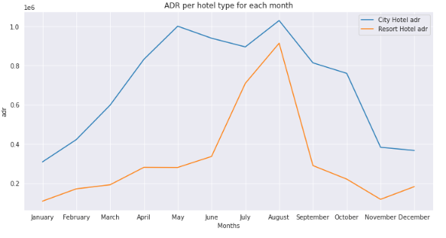
Month wise analysis...
This line chart shows ADR for hotels for each month.
The ADR for City Hotel is highest for the months May and August.
The ADR for Resort Hotel is highest for the August month.
The ADR for City Hotel is more expensive than Resort Hotel for each month.

Slide 19

Room wise analysis
Which room type have the most demand?
How many rooms wrongly assigned to with respect to booked room type by each hotel?
Which room type generates highest ADR?

Slide 20
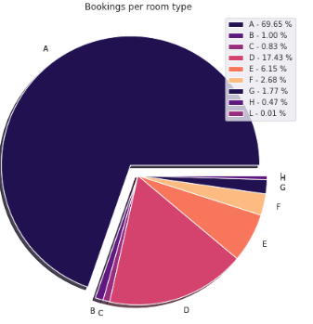
Room wise analysis...
This pie chart shows the highest booking for room type.
We can clearly visualise that room type A had more demand compared to other .
After A , D gets the leading .
Room type H has the least booking rate.

Slide 21
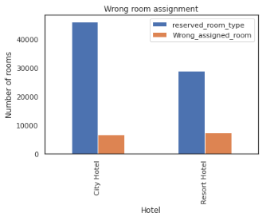
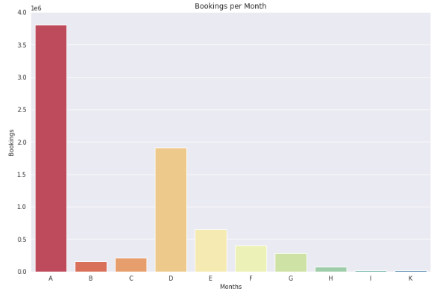
Room wise analysis...
The bar chart on the right side shows the wrong room assigned with respect to booked room type.
In resort hotel 7334 room assigned wrong i.e. 25.4% of total reserved room type in resort hotel.
In city hotel 6661 room assigned wrong i.e.14.5% of total reserved room type in city hotel.
The chart on the left side defines the room type which generates high ADR.
We can see that room type a has the highest ADR.
Next to A type room D room type has highest ADR.

Slide 22
Summary
More than 60% of the population booked the City hotel.
Total bookings got cancelled 37% of total booking. Most of the booking cancelled for City hotel during the year of 2016 and 2017
that is 61% of total booking cancelled.
Most of the bookings were made in the year 2016 compared to other years.
Most bookings were made by online TA market segment.
More repeated guest bookings were made in 2016, compared to the previous year. But the bookings decreased by almost 15% the
next year.
Most of the wrong room assigned was with resort hotel compared to city hotel.
Majority of visitors travel in pairs.
The visitors from Portugal has highest booking rate prior to countries UK, France, Spain and Germany also holds a great portion in bookings.
Most bookings were made from July to August. And the least bookings were made at the start and end of the year.
Room type A has the most demand compared to other room types.
The ADR is highest with city hotel with respect to room type and month wise.

Slide 23
Challenges
Data was present in wrong data type format.
Choosing appropriate visualization techniques to use was difficult.
A lot of null values were there in the dataset.

Slide 24
Thank You

